Slide 1
PUBPOL 599: Data-Driven Management and Policy
Week 2

Slide 2
Experiments
Data
Combining those two things

Slide 3
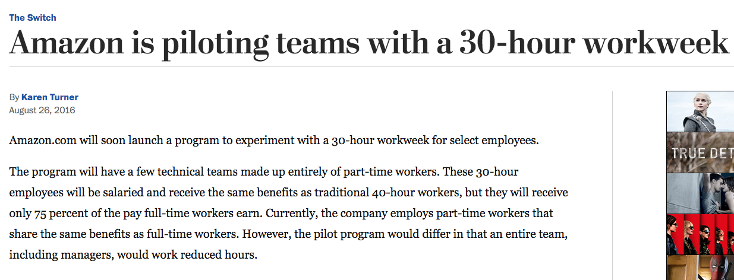

Slide 5
Experiments in Organizations
Clear experiments with feedback loops
Intelligent fast failure (minimum viable products)
An open culture
Steal from others and share yourself
A common vision

Slide 6
Experiments Within Yourself
Clear experiments with feedback loops
Intelligent fast failure (minimum viable products)
An open culture
Steal from others and share yourself
A common vision
Clear experiments with feedback loops
Intelligent fast failure (minimum viable products)
An open culture
Steal from others and share yourself
A common vision

Slide 7
Experiment Design

Slide 8
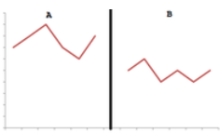

Slide 9
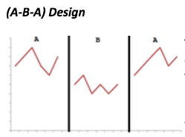

Slide 10
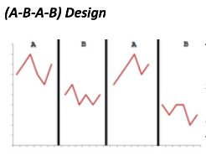

Slide 11
Basic Final Project Design
Two week collection baseline
Two week collection to test treatment
Experiment

Slide 12
Project Timeline
April 8th – you are here (unless you’re watching the tapped version)
April 15th – have data streams selected and begin collecting baseline data
April 29th – Conduct/begin experiment
May 13th – Finish data collection post-treatment
Final Project due June 10th

Slide 13
Slightly More Advanced Final Project Design
Two week collection baseline
Experiment
Un - Experiment

Slide 14
Project Timeline
April 8th – you are here (unless you’re watching the tapped version)
April 15th – have data streams selected and begin collecting baseline data
April 29th – Conduct/begin experiment
May 13th – Finish data collection first round of experiment
May 27th – Finish data collection second round
Final Project due June 10th

Slide 15
Data Sources

Slide 16
Data Streams
Passive Data Collection: via sensors like FitBit, mobile phones
Active Data Collection: Self-recorded measures
Administrative Data: Logged via activities
Lots of options - should be collected at least daily

Slide 17
Passive Data Sources
Collects without asking you (but you choose to wear)
Most fitness trackers combine steps, activity, sleep, gps, heartrate…
Fitbit
Nike Fuelband
Jawbone UP
Senkefei ($14)
Seegar ($20)
Arbily ($25)
AmazFit Smarwatch ($80)
Phones can track steps too, apps can track sleep

Slide 18
Active Data Sources
You must submit data
Food diaries (can be combined with fitness tracker)
Meal Snap – App ($2)
Mood trackers
Moodpanda
In Flow
Moodscope
AskMeEvery

Slide 19
Administrative
Collects passively, but with less direct permission than passive. An indirect record of activity
RescueTime
Credit Card Transactions
Apple/Android time tracking

Slide 20
What is required?
Collect at least one of each data source (passive, active, administrative).
Can collect more! Will give more options in two weeks when designing experiment
Lab 3 will ask you to identify what you’re collecting, you’ll want to start that day.

Slide 21
Putting it all together

Slide 22
Designing an experiment
What am I doing?
Passive data
Steps and Sleep from my FitBit
Active Data
Record happiness every day
Time I get in bed (pen and paper)
Administrative Data
RescueTime

Slide 23
Designing an experiment
Needs to be quantifiable!
If I’m more productive am I happier?
If I increase my productivity score on RescueTime, does self reported happiness increase?
Does getting into bed by 10 every night help me sleep better
Does sleep time or quality increase in period B?

Slide 24
Our common vision
You’ll understand different types of data that can be collected as an organization (passive, active, and administrative) and he able to think about the different structures and problems with each
Be able to apply those different data to the development of experiments that actually test something
Be able to interpret whether the experiment succeeded and display the results in a digestible manner
(and to do all of that learn some things in R)

